Slide 1
Identification of Post-translational Modifications
For Sample Prep

Slide 2
Complexity of the Proteome
Protein processing and modification comprise an important third dimension of information, beyond those of DNA sequence and protein sequence.
Many things can change cell components and their PTM’s:
cell cycle
environmental conditions
developmental stage
metabolic state.
Proteomic approaches don’t just identify proteins but also find their post-translational modifications are needed!

Slide 3
Post-translational Modification
What purpose ?
- targeting (eg. some lipoproteins)
- stability (eg. secreted glycoproteins )
- function (eg. surface glycoproteins)
- control of activity (eg. clotting factors, caspases)
How can we study it ?

Slide 4
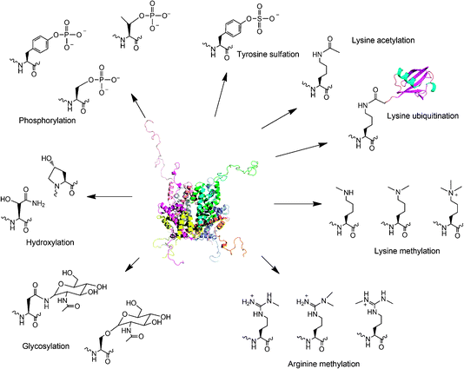

Slide 5
Definitions of the components:
1. Post-translational modification (PTM): Chemical modifications at certain amino acid residues - after the protein is synthesized by translation - are known as post-translational modifications. These are essential for normal functioning of the protein. Some of the most commonly observed PTMs include:
a) Phosphorylation: The process by which a phosphate group is attached to certain amino acid side chains in the
protein, most commonly serine, threonine and tyrosine.
b) Glycosylation: The attachment of sugar moieties to nitrogen or oxygen atoms present in the side chains of amino
acids like asparagine, serine or threonine.
c) Acylation: The process by which an acyl group is linked to the side chain of amino acids like asparagine, glutamine or
lysine.
d) Alkylation: Addition of alkyl groups, most commonly a methyl group to amino acids such as lysine or arginine. Other
longer chain alkyl groups may also be attached in some cases.
e) Hydroxylation: This PTM is most often found on proline and lysine residues which make up the collagen tissue. It
enables crosslinking and therefore strengthening of the muscle fibres.

Slide 6
Definitions of the components
2. Protein translation: The process by which the mRNA template is read by ribosomes to synthesize the corresponding protein molecule on the basis of the three letter codons, which code for specific amino acids.
3. Cytosol: A cellular compartment that serves as the site for protein synthesis.
4. Signal sequence: A sequence that helps in directing the newly synthesized polypeptide chain to its appropriate intracellular organelle. This sequence is most often cleaved following protein folding and PTM.
5. Endoplasmic reticulum: A membrane-bound cellular organelle that acts as a site for post-translational modification of the newly synthesized polypeptide chains.
6. Cleaved protein: The protein product obtained after removal of certain amino acid sequences such as N- or C-terminal sequences, signal sequence etc.

Slide 7
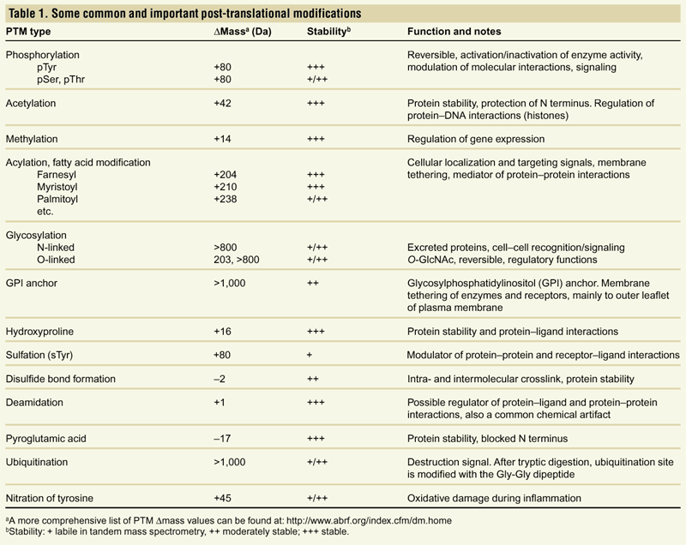
Proteomic analysis of PTMs
Mann and Jensen, Nature Biotech. 21, 255 (2003)

Slide 8
Adduct formation – expect the unexpected
…around 290 different adducts
Statistics: Adducts in NIST12 MS/MS DB (80,000 spectra)
Most common adducts for LC-MS ([M+H]+ [M+Na]+ [M+NH4]+ [M+acetate]+)

Slide 9
ExPASy – the proteomic server

Slide 10
Different types of PTMs & their modification sites
Ser, Thr, Tyr
Pro, Lys
Asn, Ser, Thr
Lys, Arg
Asn, Gln, Lys

Slide 11
Process of post-translational modification
Translated Protein
mRNA
Cytosol
Ribosome
P
Endoplasmic reticulum (ER)
P
Protein folding & PTMs
Removal of certain N- and C-terminal residues
CH₃
CH₃
Cleaved protein
Protease
Glc
Glc
Source: Modified from Biochemistry by A.L.Lehninger, 4th edition (ebook)

Slide 12
Increased complexity of proteome due to PTMs
A
A
C
G
G
U
G
C
C
G
U
G
C
A
C
G
C
A
C
U
A
C
G
C
A
C
U
Expected protein structure
Gene sequence
Actual protein structure
Asn
Asn
Gly
Ala
Glc
Ala
His
Gly
CH₃
P
Val
His
Ala
Val
Ala
Leu
Arg
Arg
Thr
Leu
Thr

Slide 13
Phosphorylation reactions
COO⁻
COO⁻
Kinase
H
C
R
OH
H
C
R
O
PO₄³⁻
NH₃⁺
ATP
ADP
NH₃⁺
Amino acid residue
Phosphorylated residue
CH₂
Ser
CH
Thr
R
CH₃
CH₂
Tyr
Source: Modified from Biochemistry by A.L.Lehninger, 4th edition (ebook)

Slide 14
Glycosylation reactions
N-linked Glycosylation
COO⁻
Sugar residues
COO⁻
Glycosyl transferase
H
C
CON
H
C
CH₂
CONH₂
CH₂
NH₃⁺
NH₃⁺
Asn
N-linked amino acid
O-linked Glycosylation
COO⁻
COO⁻
Glycosyl transferase
H
C
R
O
H
C
R
OH
NH₃⁺
NH₃⁺
Ser/Thr
O-linked amino acid
Source: Modified from Biochemistry by A.L.Lehninger, 4th edition (ebook)

Slide 15
Definitions of the components: Gel-based detection techniques for PTMs
1. Pro-Q-diamond: This fluorescent dye detects modified proteins that have been phosphorylated at serine, threonine or tyrosine residues. They are used with electrophoretic techniques and offer sensitivity down to few ng levels, depending upon the format in which they are used. This dye can also be combined with other staining procedures thereby allowing more than one detection protocol on a single gel.
a) Gel staining: The process by which the protein bands on an electrophoresis gel are stained by suitable dyes for visualization.
b) Gel scanning: The visualization of the stained protein bands on an electrophoresis gel by exciting it at a suitable maximum wavelength such that the dye absorbs the light and emits its own characteristic light at another emission wavelength.
2. Immunoblotting: This process, also known as Western blotting, is a commonly used analytical technique for detection of specific proteins in a given mixture by means of specific antibodies to the given target protein.
a) Electrophoresis: Electrophoresis is a gel-based analytical technique that is used for separation and visualization of biomolecules like DNA, RNA and proteins based on their fragment lengths or charge-to-mass ratios using an electric field. The protein mixture is first separated by means of a suitable electrophoresis technique such as SDS-PAGE or Two-dimensional Electrophoresis.

Slide 16
Definitions of the components: Gel-based detection techniques for PTMs
b) Blotting: The process by which the proteins separated on the electrophoresis gel are transferred on to another surface such as nitrocellulose by placing them in contact with each other.
c) Nitrocellulose sheet: A membrane or sheet made of nitrocellulose onto which the protein bands separated by electrophoresis are transferred for further probing and analysis.
d) Specific probe antibodies: Antibodies that are specific to a particular protein modification can be used as probes to detect those proteins containing that particular PTM. Protein phosphorylation is commonly detected using anti-phosphoserine, phosphothreonine or phosphotyrosine antibodies. Recently, specific motif antibodies have also been developed which detect a particular sequence of motif of the protein that contains a PTM.
e) Labeled secondary Abs: Antibodies labeled with a suitable fluorescent dye molecule are used to detect the interaction between the modified protein and its antibody by binding to another domain of the probe antibody.

Slide 17
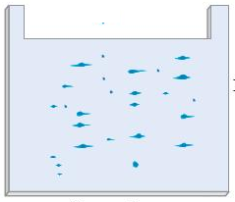
Pro-Q-diamond staining
Dye stains the phosphorylated protein bands only.
Protein bands get fixed on gel and minimize diffusion.
Excess dye removed
Completed 2-DE gel
Tubing connected & outlet opened
Tray with fixing solution (methanol + acetic acid)
Pro-Q-diamond stain
Washing solution (methanol + acetic acid)

Slide 18
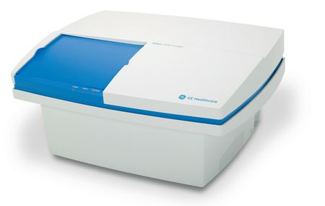
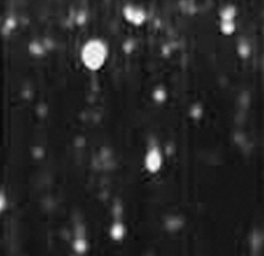
Gel scanning
Gel scanner
Stained gel
Emission maxima – 580 nm
Gel removed from scanner
Decreasing molecular weight
Phosphoprotein image
Decreasing pH

Slide 19
Dual staining with SYPRO-Ruby Red
Dye stains all protein bands.
Excess dye removed
Tubing connected & outlet opened
SYPRO-Ruby red staining solution
Washing solution (methanol + acetic acid)

Slide 20
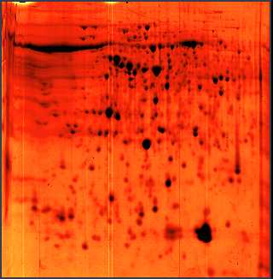
Gel scanning
Fluorescence
Gel scanner
Stained gel
Phosphoprotein image
Phosphoprotein image
Emission maxima – 610 nm
Total protein image
Fluorescence
Decreasing molecular weight
A comparative profile between total protein image and phosphoprotein image enables detection of phosphorylated proteins.
Total protein image by SYPRO-Ruby Red
Decreasing pH

Slide 21
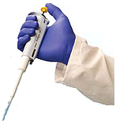
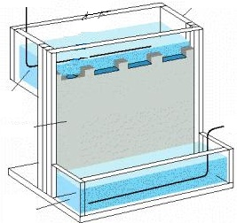
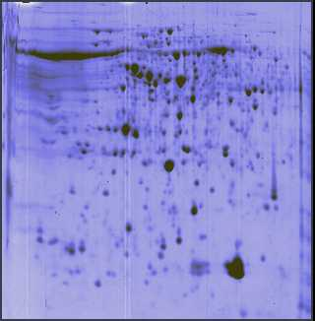
Immunoblotting
Proteins focused on IPG strip
SDS-PAGE
2-D Electrophoresis
Sample loading
-
Cathode
Protein mixture
Direction of migration
Direction of migration
Acrylamide gel
+
Anode
Buffer
Completed stained gels

Slide 22
Immunoblotting (this one for phosphorylated tyrosines!)
Proteins phosphorylated at Tyr residues
Completed gels
Nitrocellulose sheet or PVDF
Specific phospho-tyrosine antibodies added
Detection using labeled secondary antibodies
Blotting
Proteins phosphorylated at Tyr residues

Slide 23
PHOSPHORYLATION

Slide 24
Phospho – Proteomics Western 2D gel , Ab specific to phospho-tyrosine

Slide 25
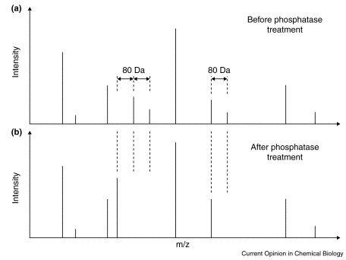
Phosphorylation and Mass Spec
Analysis of the entire complement of phosphorylated proteins in cells: “phosphoproteome”
Qualitative and quantitative information regarding protein phosphorylation important in many cellular processes
signal transduction, gene regulation, cell cycle, apoptosis
Most common sites of phosphorylation: Ser, Thr, Tyr
MS can be used to detect and map locations for phosphorylation
MW increase from addition of phosphate group
treatment with phosphatase allows determination of number of phosphate groups
digestion and tandem MS allows for determination of phosphorylation sites

Slide 26
Enrichment strategies to analyze phosphoproteins/peptides
Chemical derivatization
Introduce affinity tag to enrich for phosphorylated molecules
e.g., biotin binding to immobilized avidin/streptavidin

Slide 27
Enrichment strategies to analyze phosphoproteins/peptides
Oda et al., Nature Biotech. 2001, 19, 379 for analysis of pS and pT
Remove Cys-reactivity by oxidation with performic acid
Base hydrolysis induce ß-elimination of phosphate from pS/pT
Addition of ethanedithiol allows coupling to biotin
Avidin affinity chromatography to purify phosphoproteins
AND MORE~!

Slide 28
Enrichment strategies to analyze phosphoproteins/peptides
Phosphospecific antibodies
Anti-pY quite successful
Anti-pS and anti-pT not as successful, but may be used
(M. Grønborg, T. Z. Kristiansen, A. Stensballe, J. S. Andersen, O. Ohara, M. Mann, O. N. Jensen, and A. Pandey, “Approach for Identification of Serine/Threonine- phosphorylated Proteins by Enrichment with Phospho-specific Antibodies.” Mol. Cell. Proteomics 2002, 1:517–527.
Immobilized metal affinity chromatography (IMAC)
Negatively charged phosphate groups bind to postively charged metal ions (e.g., Fe³⁺, Ga³⁺) immobilized to a chromatographic support
Limitation: non-specific binding to acidic side chains (D, E)
Derivatize all peptides by methyl esterification to reduce non-specific binding by carboxylate groups.
Ficarro et al., Nature Biotech. (2002), 20, 301.

Slide 29
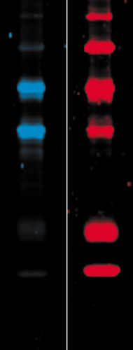
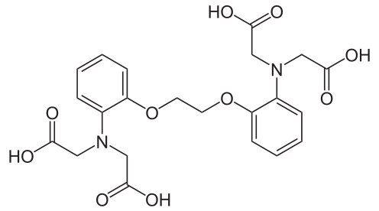
Phosphoprotein and Sypro Ruby Stains with Laser Imaging
Beta-galactosidase
Bovine serum albumin (BSA)
Ovalbumin
Beta-casein
Avidin
lysozyme
PeppermintStick phosphoprotein molecular weight standards (LifeTechnologies) separated on a 13% SDS polyacrylamide gel.
The gel was stained with Pro-Q Diamond phosphoprotein gel stain (blue) followed by SYPRO Ruby protein gel stain (red).
The digital images were pseudocolored
Phosphorylated
BAPTA

Slide 30
Phosphoprotein Stain
Visualization of total protein and phosphoproteins in a 2-D gel
Proteins from a Jurkat T-cell lymphoma line cell lysate separated by 2-D gel electrophoresis and stained with Pro-Q Diamond phosphoprotein gel stain (blue) followed by SYPRO Ruby protein gel stain (red).
After each dye staining, the gel was imaged and the resulting composite image was digitally pseudocolored and overlaid.
T.H. Steinberg et al., Global quantitative phosphoprotein analysis using Multiplexed Proteomics technology, Proteomics 2003, 3, 1128-1144

Slide 31
GLYCOSYLATION

Slide 32
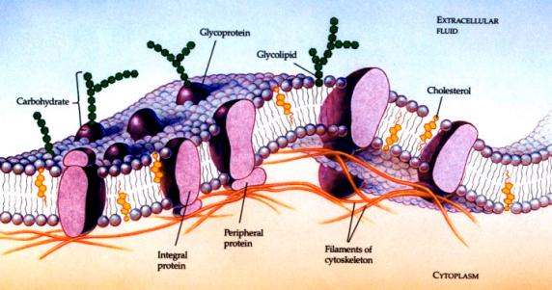

Slide 33
Protein Glycosylation
The most important and complex form of PTM
Approx. 1% mammalian genes
Early view about carbohydrates (non-specific, static structures) has been challenged
Ann. Rev. Biochem. 72(2003)643

Slide 34
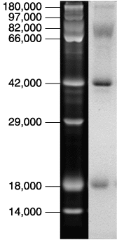
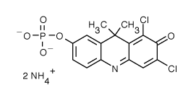
Glycoprotein Gel Stain
Detection of glycoproteins and total protein on an SDS-polyacrylamide gel using the Pro-Q Fuchsia Glycoprotein Gel Stain Kit.
CandyCane glycoprotein molecular weight standards (LifeTechnologies) containing alternating glycosylated and nonglycosylated proteins electrophoresed through a 13% polyacrylamide gel.
After separation, the gel was stained with SYPRO Ruby protein gel stain to detect all eight marker proteins (left). Subsequently, the gel was stained by the standard periodic acid–Schiff base (PAS) method in the Pro-Q Fuchsia Glycoprotein Gel Stain Kit to detect the glycoproteins alpha₂-macroglobulin, glucose oxidase, alpha₁-glycoprotein and avidin.
Pro-Q™ Glycoprotein Stain (DDAO phosphate)
Molecular Formula: C₁₅H₁₈Cl₂N₃O₅P (MW 422.20)

Slide 35
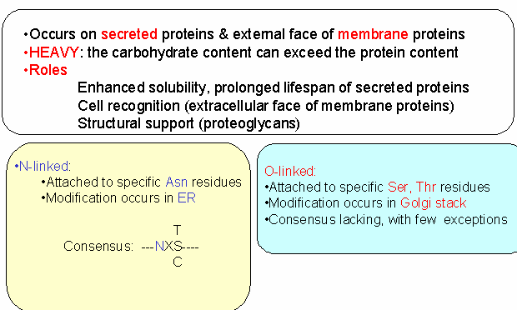
Protein Glycosylation Common in Eukaryotic Proteins

Slide 36
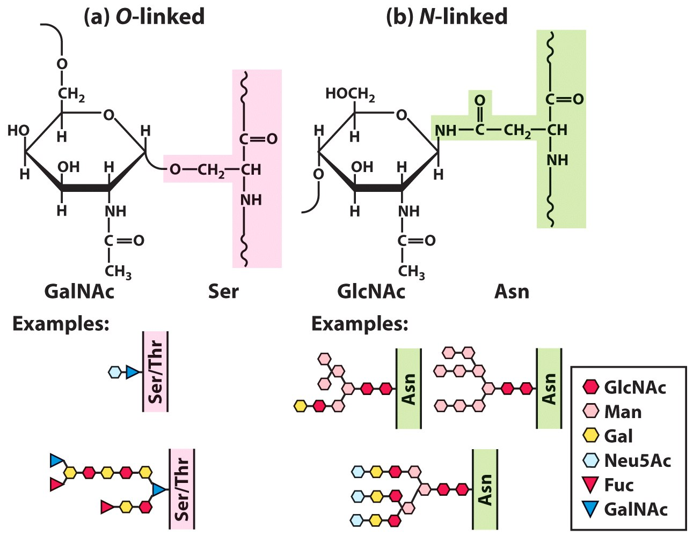

Slide 37
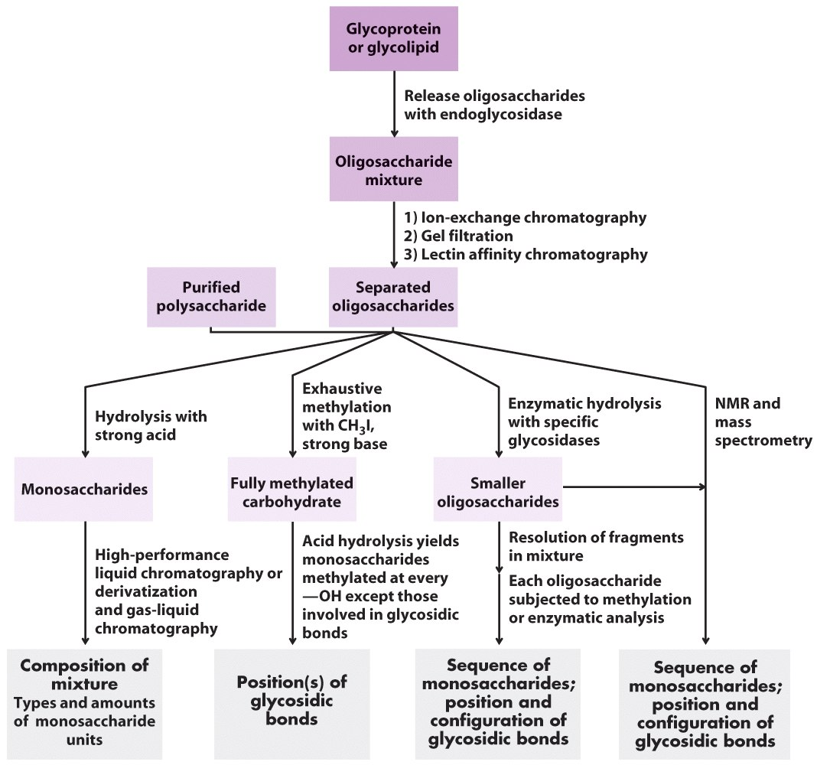

Slide 38
NITRATION

Slide 39
Nitro-Tyrosine Modification
Oxidative modification of amino acid side chains:
methionine oxidation to the corresponding sulfone
S-nitrosation or S-nitrosoglutationylation of cysteine residues
Tyrosine modification to yield o,o’-dityrosine, 3-nitrotyrosine and 3-chlorotyrosine.
Tyrosine nitration is a well-established protein modification that occurs in disease states associated with oxidative stress and increased nitric oxide synthase activity.
The combination of 2D-PAGE, western blotting, IMMUNOASSAY and mass spectrometry has been the more typical strategy to identify 3-nitrotyrosine-modified proteins.

Slide 40
Nitro-Tyrosine Modification
“Proteomic method identifies proteins nitrated in vivo during inflammatory challenge,” K. S. Aulak, M. Miyagi, L. Yan, K. A. West, D. Massillon, J. W. Crabb, and D. J. Stuehr, Proc. Natl. Acad. Sci. USA 2001; 98: 12056-12061.
Anti-nitrotyrosine immunopositive proteins in lung of rats induced with LPS.

Slide 41
WHAT WE DO AT OSU…

Slide 42
SERVICES at OSU Proteomics
Protein Growth, Induction and Expression, Protein purification
Subcloning into recombinant cell lines, Plasmid design
DIGE
Develop novel protein protocols, individualized for experiment
Selective subfractionation, Salt fractionation, Enrichment, Solubility screening, Inclusion body isolation
Western Blotting, Far Western Blotting, Immunoprecipitation and Co-immunoprecipitation, Protein-Protein interaction studies
Classic chromatography:
Affinity –Tag purification, ionic exchange, HIC reverse phase, SEC gel chromatography 100,300, Immobilized metal affinity chromatography (IMAC), Heparin affinity: Protein A/G affinity column, ENDOTOXIN removal
SDS-PAGE and DNA Electrophoresis, reduced and/or non-reduced
ProQ, LavaPurple, Sypro and other gel staining
Fluorescent and Bradford Protein Quantitation
Mass Spectrometry for protein identification
Just ask!
PTM identification!

Slide 43
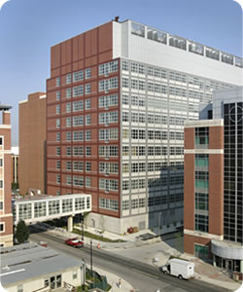
THANKS FOR LISTENING! You can find us at…
Mass Spec and Proteomics and
Protein Expression and Purification
Facility
Biomedical Research Tower Room 250
460 West 12th Street
Columbus, Ohio
Lab: 614-247-8789
Arpad Somogyi, PhD – somogyi.16@osu.edu
Cindy L. James, PhD – james.456@osu.edu

